Slide 1
Conditionals
Unit 2.04

Slide 2
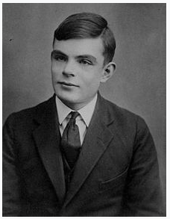
Who Is this?

Slide 3
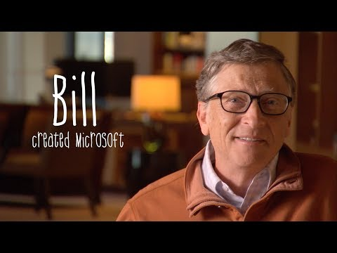
Our programs make decisions just like we do. Here is an example of how using a graphical language.

Slide 4
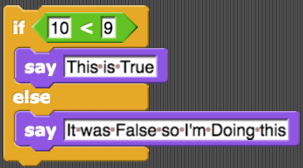
Conditionals
Conditionals are how programs make decisions
Blast from the Past!
What if we wanted to test more than one condition AND do something different?

Slide 5
Conditionals
Let’s convert it to Python
if 10 < 9:
print(“This is True”)
else:
print(“It was False so I’m Doing this”)

Slide 6
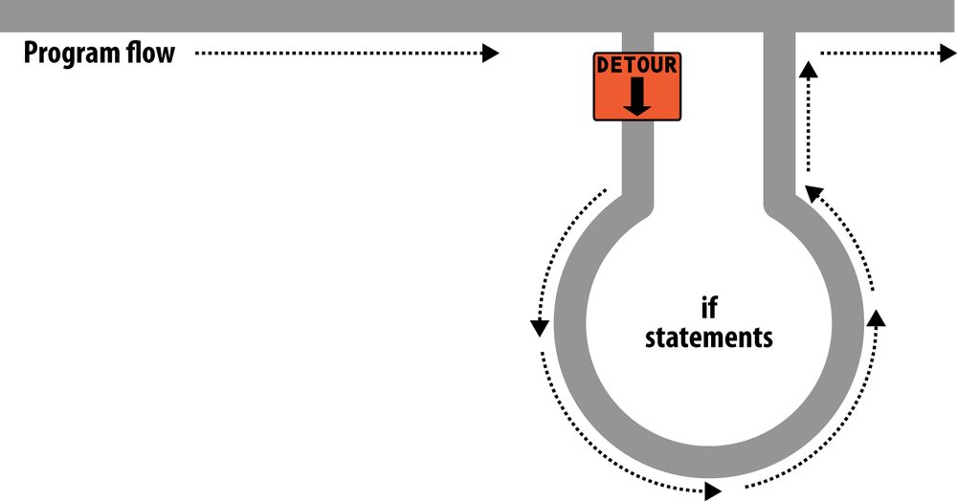
Conditionals
Program Flow Control
Conditionals allow us to control the flow of a program.
if statement
if “TRUE”:
Do Something

Slide 7
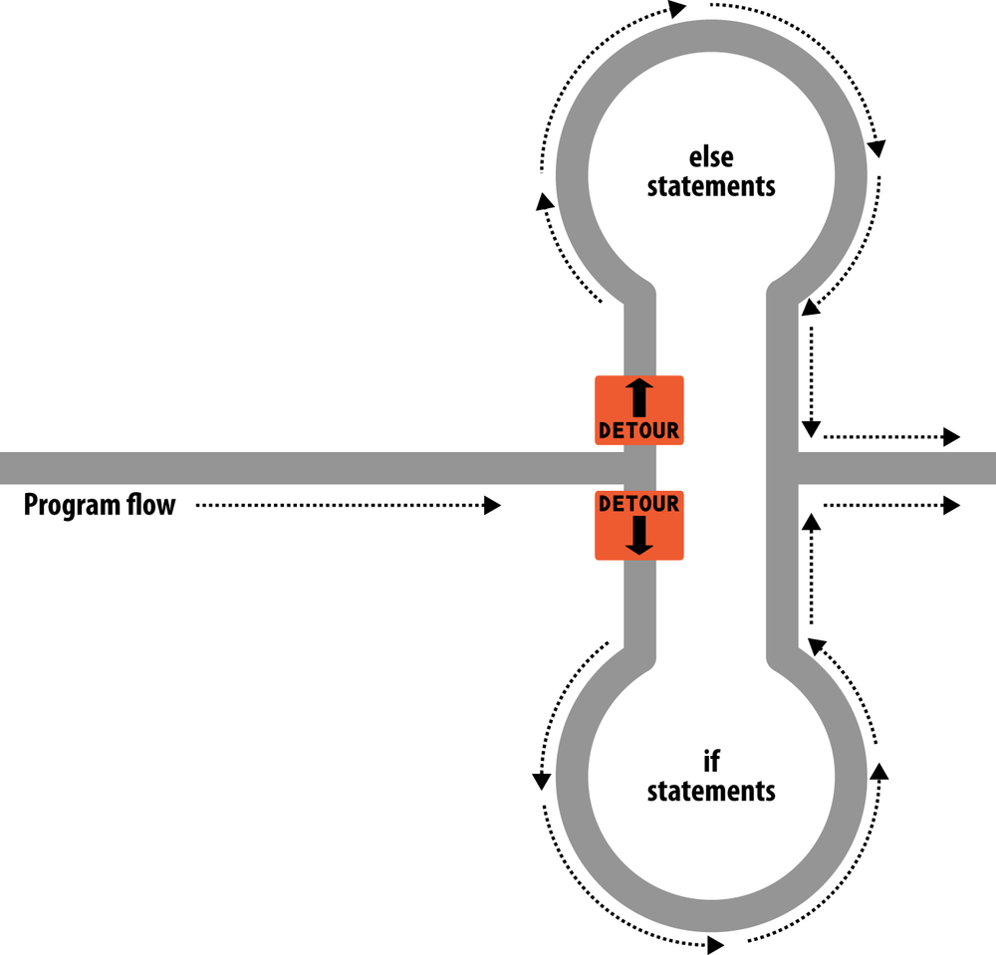
Conditionals
Program Flow Control
Conditionals allow us to control
the flow of a program.
else statement
if “TRUE”:
Do Something
else:
Do Something else

Slide 8
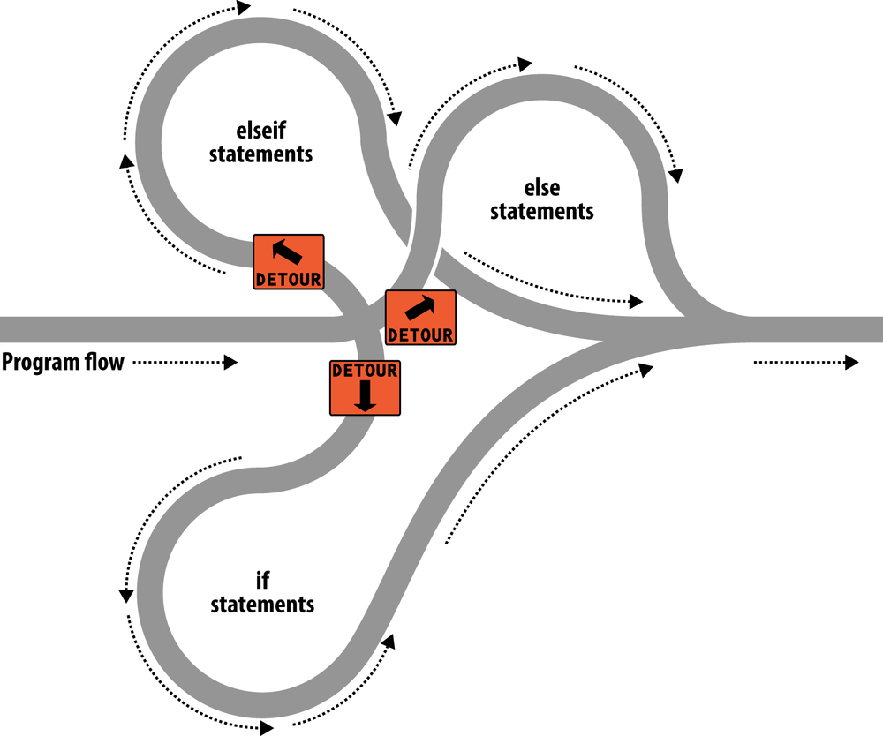
Conditionals
Program Flow Control
elif statement
if “TRUE”:
Do Something
else:
Do This instead
elif “TRUE”:
Do Something Else

Slide 9
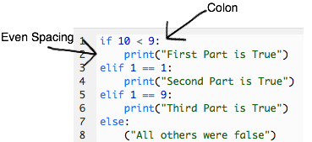
Conditionals
Syntax
The conditional statement must be followed by a colon :
The function to be run if true must be indented.
All indents must match throughout the entire program.
Recommend using 4 Spaces (PEP 8) for indentation
Once indentation ends Python assumes the block has finished

Slide 10
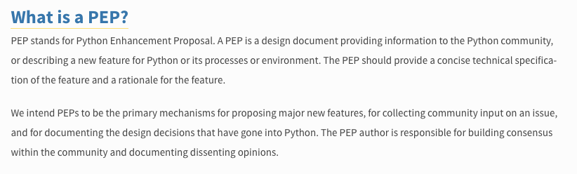
Conditionals
PEP - Python Enhancement Proposals
The Python Community has a Design Document
https://www.python.org/dev/peps/
Remember Python is community driven as an open source language

Slide 11
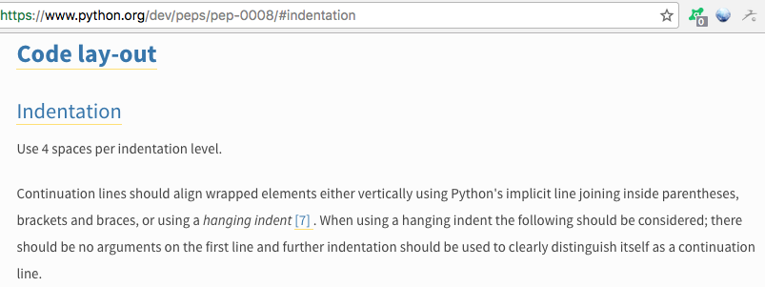
Conditionals
PEP - Python Enhancement Proposals
PEP 8 is the Python Code Style Guide.
Recommends the use of 4 spaces when indenting a block.
Avoid using the tab button instead use 4 spaces

Slide 12
Conditionals
Examples
new_player = input(“Are you a new player? “)
# test for new player and show instructions
if new_player == “yes”:
print(“Here are the game instructions”)
player_name = input(“What is your name? “)
else:
player_name = input(“What is your name? “)
print(“Welcome back “ + player_name)
player_1_age = input("Player 1, How old are you? ")
player_2_age = input("Player 2, How old are you? ")
# test which player is older
if int(player_1_age) > int(player_2_age):
print("Player 1 is older than Player 2")
elif int(player_1_age) == int(player_2_age):
print("You are both the same age")
else:
print("Player 2 is older than Player 1")

Slide 13
Conditionals
Nested Conditionals
We can nest conditionals inside other conditionals
if True:
Do Something
else:
if True:
Do this
else:
Do that instead
savings = input(“Have you saved and money? “)
if savings == “no”:
print(“it is time to start saving”)
else:
saved_money = input(“How much have you saved? “)
if int(saved_money) < 100:
print(“You need to save at least 100 dollars”)
else:
saved_per_week = input(“How much do you save a week? “)
annual_savings = int(saved_per_week) * 52
total_year = annual_savings + int(saved_money)
print(“Next year at this time you will have “ + str(total_year))

Slide 14
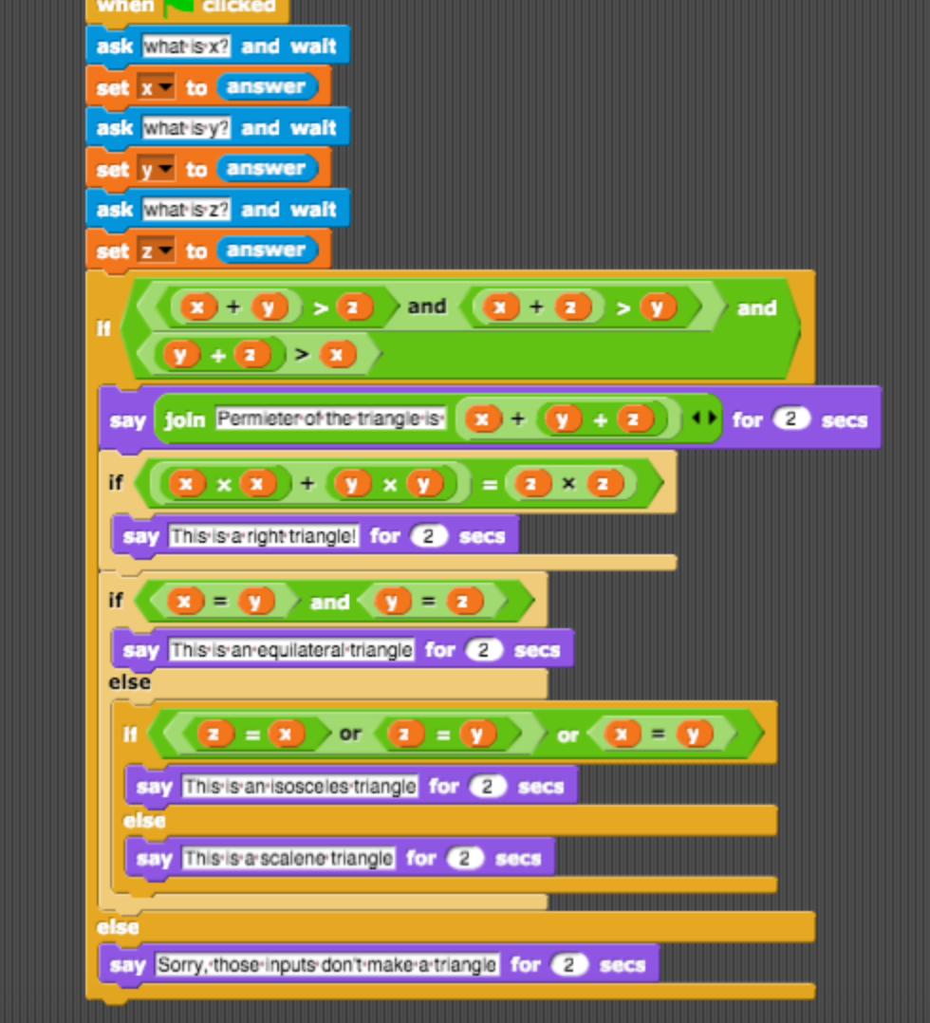
Let’s translate from SNAP to Python

Slide 15
Conditionals
Lab 2.04
Complete Lab 2.04

